Slide 1
Chapter 9 Multi-dimensional List

Slide 2
Problem
You can use a list to store linear collections of elements. How can you store two-dimensional data, such as the below table,
which provides the distances between cities?

Slide 3
Solution
You can use two-dimensional list to store two-dimensional data.
distances = [
[0, 983, 787, 714, 1375, 967, 1087],
[983, 0, 214, 1102, 1763, 1723, 1842],
[787, 214, 0, 888, 1549, 1548, 1627],
[714, 1102, 888, 0, 661, 781, 810],
[1375, 1763, 1549, 661, 0, 1426, 1187],
[967, 1723, 1548, 781, 1426, 0, 239],
[1087, 1842, 1627, 810, 1187, 239, 0]
]

Slide 4
Objectives
To give examples of representing data using two-dimensional lists.
To use nested loops
To access elements in a two-dimensional list using row and column indexes.
To program common operations for two-dimensional lists (displaying lists, summing all elements, finding min and max elements).
To pass two-dimensional lists to functions.
To write a program for grading multiple-choice questions using two-dimensional lists.
To understand pixel-based image processing
To implement basic image processing algorithms

Slide 5
Processing Two-Dimensional lists
You can view a two-dimensional list as a list that consists of rows. Each row is a list that contains the values. The rows can be accessed using the index, conveniently called a row index. The values in each row can be accessed through another index, conveniently called a column index.
len (m) is 5 #number of rows
len (m[0]) is 5 # number of columns in row 0

Slide 6
Processing Two-Dimensional lists
(Initializing lists with input values)
(Initializing lists with random values)
(Printing lists)
(Summing all elements)
(Summing all elements by row)
(Summing all elements by column)
(Which row has the largest sum)

Slide 7
Initializing lists with input values
The following loop initializes the matrix with user input values:
matrix = [] # Create an empty list
numberOfRows = int(input("Enter the number of rows: "))
numberOfColumns = int(input("Enter the number of columns: "))
for row in range(0, numberOfRows):
matrix.append([]) # Add an empty new row
for column in range(0, numberOfColumns):
value = int(input("Enter an element and press Enter: "))
matrix[row].append(value)
print(matrix)
Enter the number of rows: 3
Enter the number of columns: 4
Enter an element and press Enter: 2
Enter an element and press Enter: 3
Enter an element and press Enter: 4
Enter an element and press Enter: 5
Enter an element and press Enter: 6
Enter an element and press Enter: 5
Enter an element and press Enter: 4
Enter an element and press Enter: 3
Enter an element and press Enter: 2
Enter an element and press Enter: 1
Enter an element and press Enter: 2
Enter an element and press Enter: 3
[[2, 3, 4, 5], [6, 5, 4, 3], [2, 1, 2, 3]]

Slide 8
Initializing lists with random values
The following loop initializes a list that stores random values between 0 and 99:
import random
matrix = [] # Create an empty list
numberOfRows = eval(input("Enter the number of rows: "))
numberOfColumns = eval(input("Enter the number of columns: "))
for row in range(0, numberOfRows):
matrix.append([]) # Add an empty new row
for column in range(0, numberOfColumns):
matrix[row].append(random.randrange(0, 100))
print(matrix)
Enter the number of rows: 4
Enter the number of columns: 3
[[84, 89, 88], [59, 93, 83], [28, 17, 12], [79, 21, 96]]

Slide 9
Printing lists
To print a two-dimensional list, you have to print each element in the list by using a loop like the following:
matrix = [[1, 2, 3], [4, 5, 6], [7, 8, 9]] # Assume a list is given
for row in range(0, len(matrix)):
for column in range(0, len(matrix[row])):
print(matrix[row][column], end = " ")
print() # Print a newline
1 2 3
4 5 6
7 8 9

Slide 10
Summing all elements
Use a variable named total to store the sum. Initially, total is 0. Add each element in the list to total by using a loop like this:
matrix = [[1, 2, 3], [4, 5, 6], [7, 8, 9]] # Assume a list is given
total = 0
for row in range(0, len(matrix)):
for column in range(0, len(matrix[row])):
total += matrix[row][column]
print("Total is " + str(total)) # Print the total
Total is 45

Slide 11
Summing elements by row
For each row, use a variable named total to store its sum. Add each element in the row to total using a loop like this:
matrix = [[1, 2, 3], [4, 5, 6], [7, 8, 9]] # Assume a list is given
for row in range(len(matrix)):
total = 0
for column in range(len(matrix[0])):
total += matrix[row][column]
print("Sum for column", row, "is", total)
Sum for column 0 is 6
Sum for column 1 is 15
Sum for column 2 is 24

Slide 12
Summing elements by column
For each column, use a variable named total to store its sum. Add each element in the column to total using a loop like this:
matrix = [[1, 2, 3], [4, 5, 6], [7, 8, 9]] # Assume a list is given
for column in range(len(matrix[0])):
total = 0
for row in range(len(matrix)):
total += matrix[row][column]
print("Sum for column", column, "is", total)
Sum for column 0 is 12
Sum for column 1 is 15
Sum for column 2 is 18

Slide 13
Finding the Row with the Largest Sum
To find the row with the largest sum, you may use the variables maxRow and indexOfMaxRow to track the largest sum and the index of the row. For each row, compute its sum and update maxRow and indexOfMaxRow if the new sum is greater.
matrix = [[1, 2, 3], [4, 5, 6], [7, 8, 9]] # Assume a list is given
maxRow = sum(matrix[0]) # Get sum of the first row in maxRow
indexOfMaxRow = 0
for row in range(1, len(matrix)):
if sum(matrix[row]) > maxRow:
maxRow = sum(matrix[row])
indexOfMaxRow = row
print("Row " + str(indexOfMaxRow))
Row 2

Slide 14
Passing Tow-Dimensional Lists to Functions
You can pass a two-dimensional list to a function just as you pass a one-dimensional list. You can also return a two-dimensional list from a function.

Slide 15
Passing Tow-Dimensional Lists to Functions (cont’d.)
def getMatrix():
matrix = [] # Create an empty list
numberOfRows = int(input("Enter the number of rows: "))
for row in range(numberOfRows):
s = input("Enter row " + str(row) + ": ")
L = s.split()
temp = []
for col in range(len(L)):
temp.append(int(L[col]))
matrix.append(temp)
return matrix
def accumulate(m):
for row in range(len(m)):
for col in range(len(m[0])):
print(m[row][col],end=" ")
print()
def main():
m = getMatrix() # Get an list
print(m)
# Display all elements
accumulate(m)
main() # Invoke main function
Enter the number of rows: 3
Enter row 0: 1 2 3 4
Enter row 1: 2 3 4 5
Enter row 2: 3 4 5 6
[[1, 2, 3, 4], [2, 3, 4, 5], [3, 4, 5, 6]]
1 2 3 4
2 3 4 5
3 4 5 6

Slide 16
Problem: Grading Multiple-Choice Test
Suppose there are eight students and ten questions, and the answers are stored in a two-dimensional list. Each row records a student’s answers to the questions.
Objective: write a program that grades multiple-choice test.

Slide 17
def main():
# Students' answers to the questions
answers = [
['A', 'B', 'A', 'C', 'C', 'D', 'E', 'E', 'A', 'D'],
['D', 'B', 'A', 'B', 'C', 'A', 'E', 'E', 'A', 'D'],
['E', 'D', 'D', 'A', 'C', 'B', 'E', 'E', 'A', 'D'],
['C', 'B', 'A', 'E', 'D', 'C', 'E', 'E', 'A', 'D'],
['A', 'B', 'D', 'C', 'C', 'D', 'E', 'E', 'A', 'D'],
['B', 'B', 'E', 'C', 'C', 'D', 'E', 'E', 'A', 'D'],
['B', 'B', 'A', 'C', 'C', 'D', 'E', 'E', 'A', 'D'],
['E', 'B', 'E', 'C', 'C', 'D', 'E', 'E', 'A', 'D']]
# Key to the questions
keys = ['D', 'B', 'D', 'C', 'C', 'D', 'A', 'E', 'A', 'D']
# Grade all answers
for i in range(len(answers)):
# Grade one student
correctCount = 0
for j in range(len(answers[i])):
if answers[i][j] == keys[j]:
correctCount += 1
print("Student", i, "'s correct count is", correctCount)
main() # Call the main function
Student 0 's correct count is 7
Student 1 's correct count is 6
Student 2 's correct count is 5
Student 3 's correct count is 4
Student 4 's correct count is 8
Student 5 's correct count is 7
Student 6 's correct count is 7
Student 7 's correct count is 7

Slide 18
What Is Digital Image Processing?
Digital image processing refers to the process of using algorithms to edit and manipulate digital images.
Image processing has extensive applications in many areas, including astronomy, medicine, industrial robotics, and remote sensing by satellites.

Slide 19
What Is Digital Image Processing? (cont’d.)
A digital image is a finite collection of small, discrete picture elements called pixels.
These pixels are organized in a two-dimensional grid and represent the smallest amount of picture information that is available.
More pixels in your image mean more detail or resolution.

Slide 20
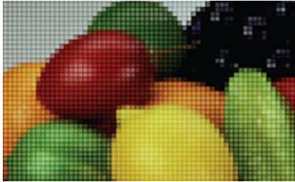
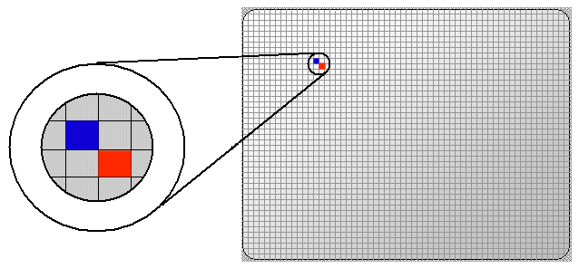

Slide 21
The RGB Color Model
Each pixel in the digital image is limited to having a single color.
The specific color depends on a formula that mixes various amounts of the primary colors red, green, and blue.
Viewing colors as a combination of red, green, and blue is often referred to as the RGB color model.
The amount of each primary color component is referred to as its intensity.
Intensities will range from a minimum of 0 to a maximum of 255.
For example, a color with 255 red intensity, 0 green intensity, and 255 blue intensity will be purple (or magenta).

Slide 22
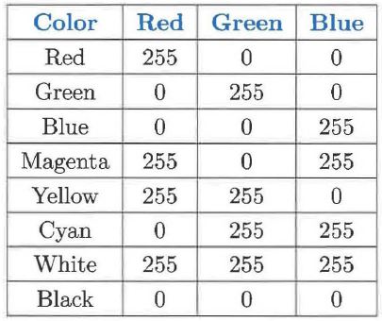
The RGB Color Model (cont’d.)
An interesting question arises when you consider how many colors there might be using the RGB color model.
Since each of the three colors has 256 intensity levels, there are different combinations of red, green, and blue intensities. All of these colors make up the color palette for the RGB color model.

Slide 23
The clmage Module
In order to manipulate images we will use a group of objects found in our cImage module.
This module contains objects that allow us to construct and manipulate pixels.
We can also construct an image from a file or create a blank image that we can fill in later.
In addition we can create windows where images can be displayed.

Slide 24
The clmage Module (cont’d.)
cImage module has five objects:
Pixel Object
ImageWin Object
Filelmage Object
Empty mage Object

Slide 25
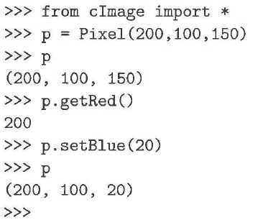
The Pixel Object
Images are collections of pixels. In order to represent a pixel, we need a way to collect together the red, green, and blue components.
The Pixel object provides a constructor and methods that allow us to create and manipulate the color components of pixels.

Slide 26
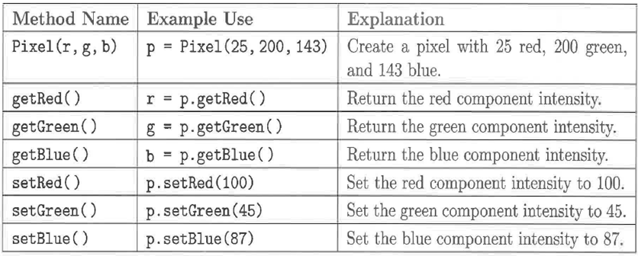
The Pixel Object (cont’d.)
Notes:
01

Slide 27

The ImageWin Object
Before creating images, we will create a window that can be used to display our images.
The ImageWin object provides a constructor that produces a window with a title, width, and height.
When a window is constructed, it is immediately shown.

Slide 28
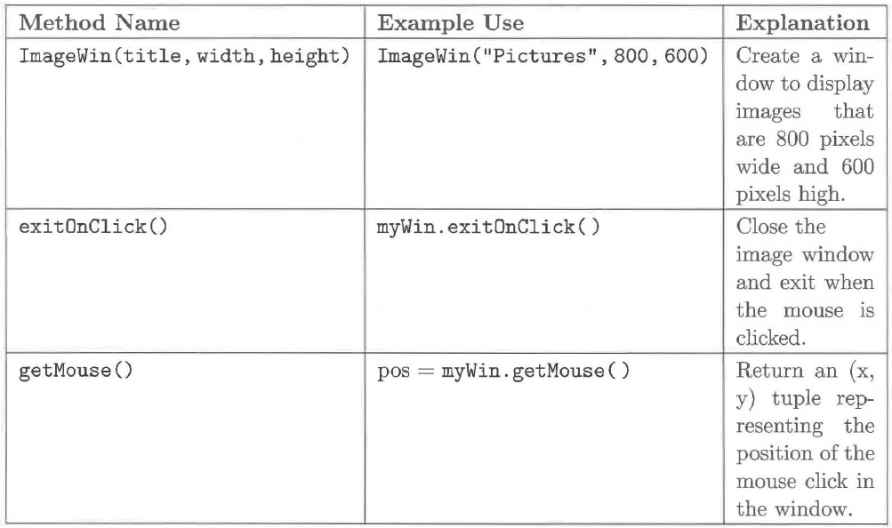
The ImageWin Object (cont’d.)
Notes:
02

Slide 29
Filelmage and Emptylmage Objects
Now that we have a window, we need to create images to display.
The cImage module provides two kinds of image objects: File Image and EmptyImage.
These objects allow us to create and manipulate images, and they give us simple access to the pixels in each image.

Slide 30
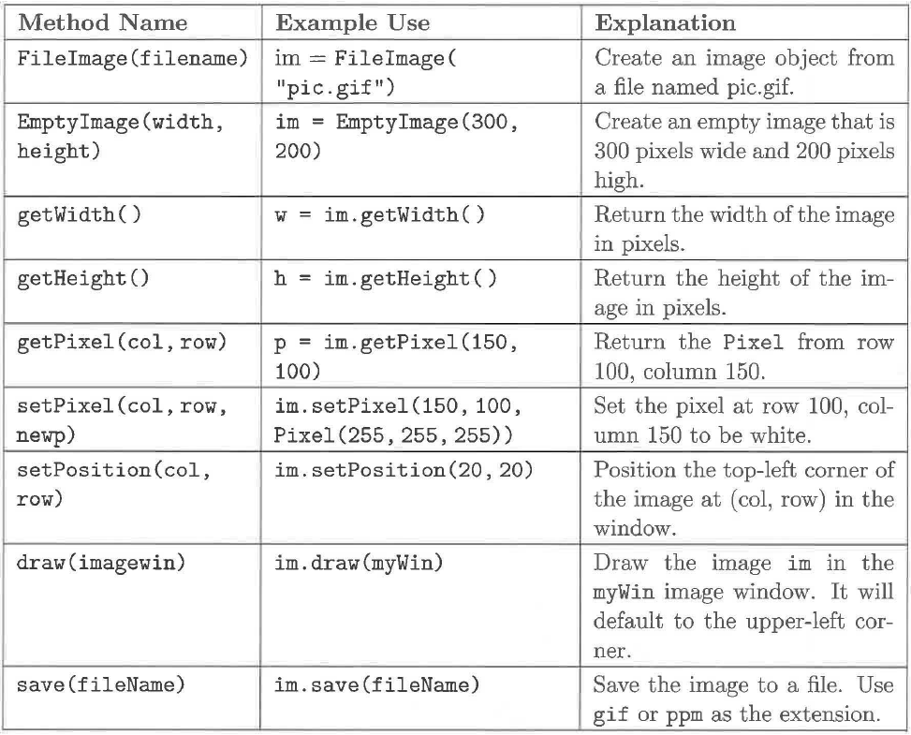
Filelmage and Emptylmage Objects (cont’d.)

Slide 31
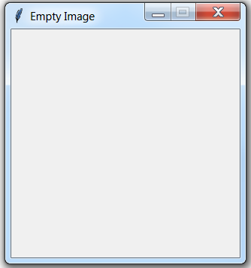
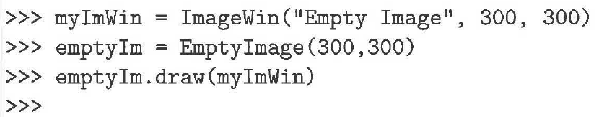
The Emptylmage Object
We often want to build a new image pixel by pixel starting with a "blank" image.
Using the EmptyImage constructor, we can create an image that has a specific width and height.
Each Pixel has the value (0,0,0) or "black."

Slide 32
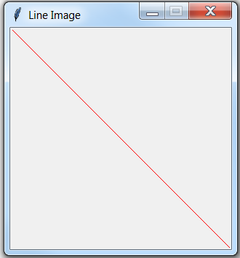
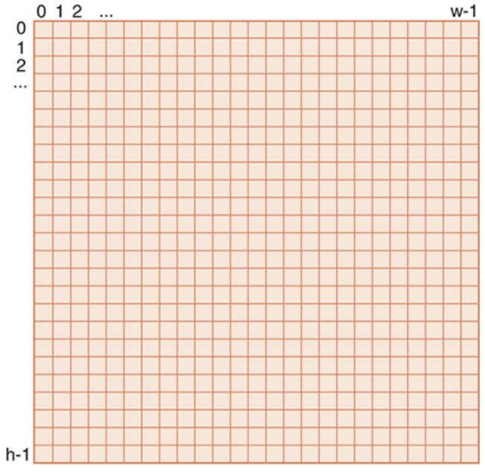
The Emptylmage Object (cont’d.)
from cImage import *
myImWin = ImageWin("Line Image",300,300)
lineImage = EmptyImage(300,300)
whitePixel = Pixel(255,0,0)
for i in range(300):
lineImage.setPixel(i,i,whitePixel)
lineImage.draw(myImWin)
lineImage.save("lineImage.gif")
myImWin.exitOnClick()

Slide 33
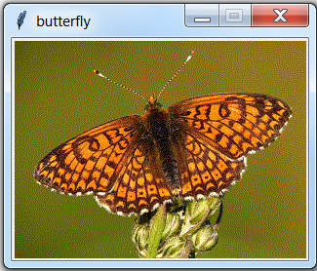
The Filelmage Object
The FileImage object is an image that is constructed from files such as those that are created by digital cameras or that reside on web pages.
from cImage import *
myWin = ImageWin("butterfly", 300,224)
butterfly = FileImage("butterfly.gif")
butterfly.draw(myWin)

Slide 34
The Filelmage Object (cont’d.)
An image is a two-dimensional grid of pixel values.
Each small square represents a pixel that can take on anyone of the millions of colors in the RGB color model.
We can access information about our specific image by using the getWidth and getHeight methods
We can access a particular pixel by using the getPixel method.
It is important to remember that we start counting at 0.

Slide 35
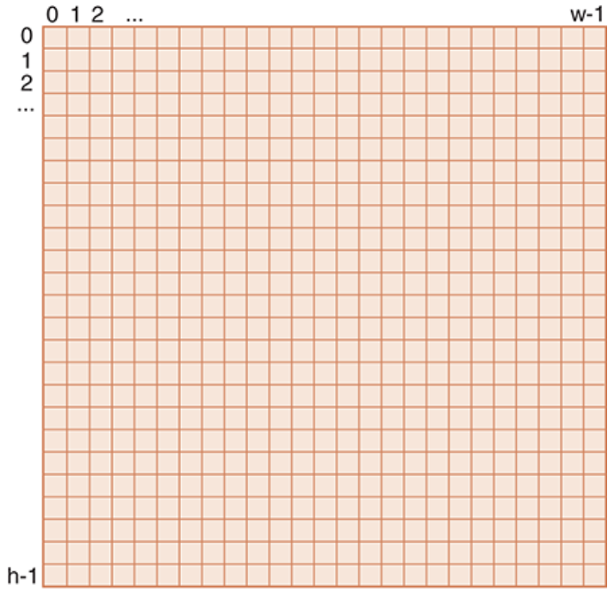
The Filelmage Object (cont’d.)
from cImage import *
butterfly = FileImage("butterfly.gif")
print(butterfly.getWidth())
print(butterfly.getHeight())
print(butterfly.getPixel(124,165)) # get pixel located at column 124, row 165
.
300
224
(102, 43, 0)

Slide 36
Basic Image Processing
Our first examples will perform color manipulations on an image.
We want to take the existing pixels and modify them in some way to change the appearance of the original image.
The basic idea will be to systematically process each pixel one at a time and perform the following operations:
1. Extract the color components.
2. Build a new pixel.
3. Place that pixel in a new image at the same location as the original.

Slide 37
Negative Images
A negative image is also known as a color-reversed image.
In a negative image, yellow becomes blue and blue becomes yellow. Regions that are white turn black, black turns white, light turns dark and dark turns light.
This continues for all possible color combinations.

Slide 38
Negative Images (cont’d.)
At the pixel level, the negative operation is just a matter of "reversing" the red, green, and blue components in that pixel.
Since color intensity ranges from 0 to 255, a pixel with a large amount of a specific color-say, red-will have a small amount in the negative.
At the maximum, a pixel with a red intensity of 255 will have a red intensity of 0 in the negative.
This suggests that the way to create a negative pixel is to subtract each of the red, green, and blue intensity values from 255. The results can then be placed in a new pixel.

Slide 39
Negative Images (cont’d.)
from cImage import *
def negativePixel(oldPixel):
newred = 255 - oldPixel.getRed()
newgreen = 255 - oldPixel.getGreen()
newblue = 255 - oldPixel.getBlue()
newPixel = Pixel(newred, newgreen, newblue)
return newPixel
apixel = Pixel(0,0,0)
print (negativePixel(apixel))
apixel = Pixel(255,255,255)
print (negativePixel(apixel))
(255, 255, 255)
(0, 0, 0)
Notes:
6.1

Slide 40
Negative Images (cont’d.)
In order to create the negative image, we call the negativePixel function on each pixel.
We can build an iteration that will systematically move through all of the rows and within each, will move through all of the columns.
This gives rise to the notion of nested loop -the placement of a loop inside of another loop.

Slide 41
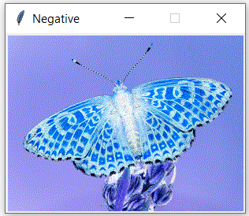
Negative Images (cont’d.)
from cImage import *
def makeNegative(imageFile):
oldImage = FileImage(imageFile)
width = oldImage.getWidth()
height = oldImage.getHeight()
myImageWindow = ImageWin("Negative", width, height)
newIm = EmptyImage(width, height)
for row in range(height):
for col in range(width):
oldPixel = oldImage.getPixel(col, row)
newPixel = negativePixel(oldPixel)
newIm.setPixel(col, row, newPixel)
newIm.draw(myImageWindow)
makeNegative("butterfly.gif")
Notes:
06.2

Slide 42
Grayscale
Another very common image color manipulation is to convert an image to grayscale.
Each pixel will be a shade of gray, ranging from very dark (black) to very light (white).
With grayscale, each of the red, green, and blue color components will take on the same value.
There are 256 different grayscale color values ranging from darkest (0, 0, 0) to lightest (255, 255, 255).
The standard color known as "gray" is typically coded as (128, 128, 128).

Slide 43
Grayscale (cont’d.)
Our task is to take each color pixel and convert it into a gray pixel.
The easiest way to do this is to consider that the intensity of each red, green, and blue component needs to play a part in the intensity of the gray.
If all of the color intensities are close to zero, the resulting color is very dark.
If all of the color intensities are closer to 255, the resulting color is very light.
We will simply take the average intensity of the red, green, and blue components.
This average can then be used for all three color components in a new pixel that will be a shade of gray.

Slide 44
Grayscale (cont’d.)
from cImage import *
def grayPixel(oldpixel):
intensitySum = oldpixel.getRed() + oldpixel.getGreen() +oldpixel.getBlue()
aveRGB = intensitySum // 3
newPixel = Pixel(aveRGB, aveRGB, aveRGB)
return newPixel
print (grayPixel( Pixel(34,128,74) ))
print (grayPixel( Pixel(200,234,165) ))
print (grayPixel( Pixel(23,56,77) ))
(78, 78, 78)
(199, 199, 199)
(52, 52, 52)
Notes:
7.1

Slide 45
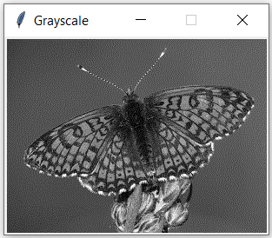
Grayscale (cont’d.)
def makeGrayScale(imageFile):
oldImage = FileImage(imageFile)
width = oldImage.getWidth()
height = oldImage.getHeight()
myImageWindow = ImageWin("Grayscale", width, height)
newIm = EmptyImage(width, height)
for row in range(height):
for col in range(width):
oldPixel = oldImage.getPixel(col, row)
newPixel = grayPixel(oldPixel)
newIm.setPixel(col, row, newPixel)
newIm.draw(myImageWindow)
makeGrayScale("butterfly.gif")
Notes:
7.2

Slide 46
Flipping an Image
We consider a process known as flipping, transform an image by moving pixels to new locations.
Creating a flip image requires that we decide where the flip will occur.
We will assume that flipping happens with respect to a line that we will call the flip axis.
The basic idea is to place pixels that appear on one side of the flip axis in a new location on the opposite side of that axis, keeping the distance from the axis the same.

Slide 47
Flipping an Image (cont’d.)
We need to discover a pattern to map each pixel from its original location into a new location with respect to the flip axis.
The general mapping equation will be
(width-1) - column.

Slide 48
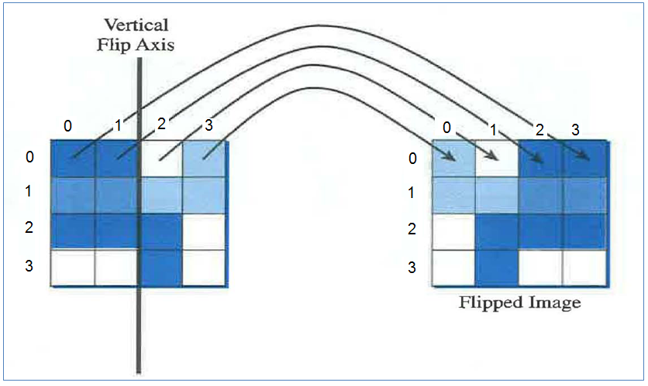
Flipping an Image (cont’d.)
Pixels in the coordinates (0,0), (1, 0), (2, 0), and (3, 0) of the original image are mapped to (3,0), (2, 0), (1,0), and (0,0)
Row number is not changing; the general mapping equation for the column number is:
(width -1) - column

Slide 49
from cImage import *
def verticalFlip(oldImage):
oldW = oldImage.getWidth()
oldH = oldImage.getHeight()
newIm = EmptyImage(oldW, oldH)
maxP = oldW - 1
for row in range(oldH):
for col in range(oldW):
oldPixel = oldImage.getPixel(col, row)
newIm.setPixel(maxP - col, row, oldPixel)
return newIm
oldImage = FileImage("flip.gif")
width = oldImage.getWidth()
height = oldImage.getHeight()
myWin = ImageWin("Vertical", width, height)
newImage = verticalFlip(oldImage)
newImage.draw(myWin)

Slide 50
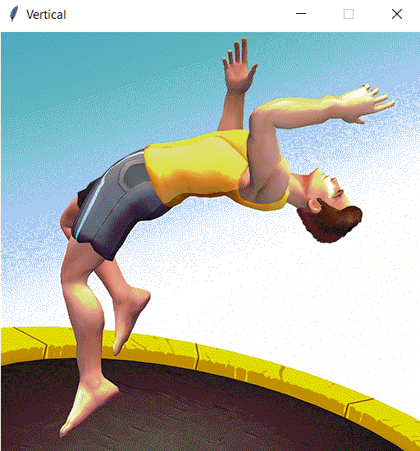
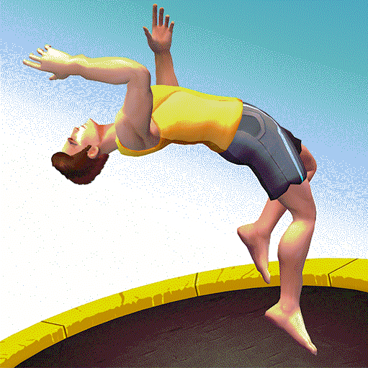
Flipping an Image (cont’d.)

